Slide 1
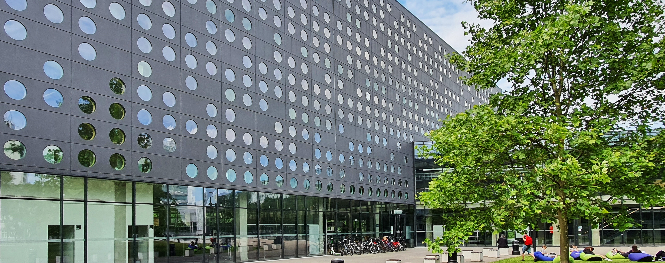
Department of Accessibility

Slide 2
For over a dozen of years, Wrocław University of Science and Technology (WUST) has been implementing the idea of a university "without barriers", open and friendly to young people with health issues.
We offer the support for Candidates, Students and PhD Students with disabilities and special needs.

Slide 3
Psychological Support and Mediation Office
We offer psychological support and help to people with different problems.
For more details, please look at the webside: dpm.pwr.edu.pl/
The Department is located L-1 building.

Slide 4
The support for people with special needs (also with disabilities)
Educational assistant
Language courses
Solutions to facilitate the functioning of people in the process of gender transition
Accessibility Leaders
Special scholarship for students with disabilities and special needs
The help with contacts on the faculty
Single rooms in dormitories

Slide 5
The support for people with with disabilities
Equipment rental
Integration and Training Camp
Teaching material adaptation

Slide 6

Contact us
Department of Accessibility
Rector's Plenipotentiary for Accessibility
phone 71 320 43 20
pomoc.n@pwr.edu.pl
Duty hours for students:
Monday - Friday 8:00 a.m. - 2:00 p.m.
(building C-13, room 1.08)
webside: dzd.pwr.edu.pl/en
phone 669 660 688
katarzyna.jach@pwr.edu.pl
Accessibility Leaders
dzd.pwr.edu.pl/en/accessibility-leaders/about-accessibility-leaders

